Slide 1
2023 Summer Skill-UP
Rayyan Baig
22th August 2023

Slide 2
Skills Learned / Upgraded
Programming Languages
Python
Java
C++
AI & ML
Maths for data science
Fundamentals of Data Engineering
Basics of AI & ML
Basic ML Libs in Python (NumPy, Pandas, Matplotlib, SciPy)
ChatGPT & Prompt Engineering
Software Development related
Microsoft Excel
Clean Code : Guidelines to Better Code
GitHub : Archive, Research and Collaborate
Regular Expressions : Text Processing
General/Misc.
Better PowerPoint Presentation

Slide 3
Time Spent vs Confidence

Slide 4
Python O’REILLY TRAINING: Python Full Throttle, Basics of Python for everybody Self Learning:- Basic training, Python libraries
Python basics from “Hello World”.
Solved Mathematical/Logical problems in Python.
prime/not prime
fibonacci series
lists/dictionary/set/tuples
Python Lib (NumPy, pandas, SciPy, matplotlib)
Python Docs training
Python tips and tricks/interview questions

Slide 5
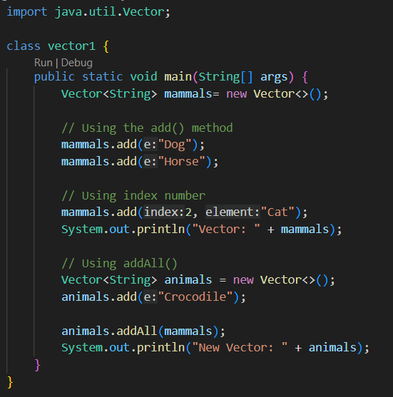
Java O’REILLY TRAINING: Java Full Throttle, Java scratch to real code Java self learning (material: college sem-2 work)
Revision on Java learned in Sem-2
Applying Clean Code learnings
Practice of Java code from Java Full Throttle
Practiced and ran over 100+ Java programs

Slide 6
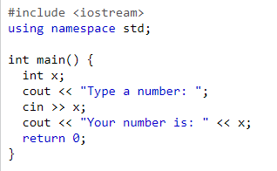

C++ O’REILLY TRAINING: C++ Full Throttle, C++ Software design
Syntax
Similarities between C++/ Java/ Python/ C

Slide 7
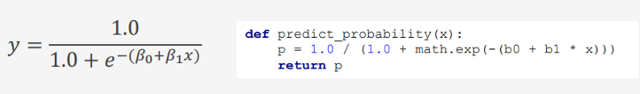
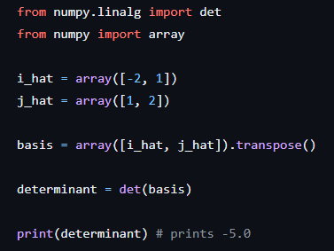
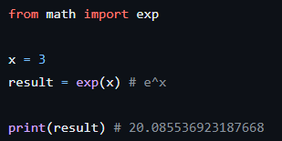
Maths for data science O’REILLY TRAINING: Essential Math for Data Science
Calculus
Linear regression
Logistic regression

Slide 8
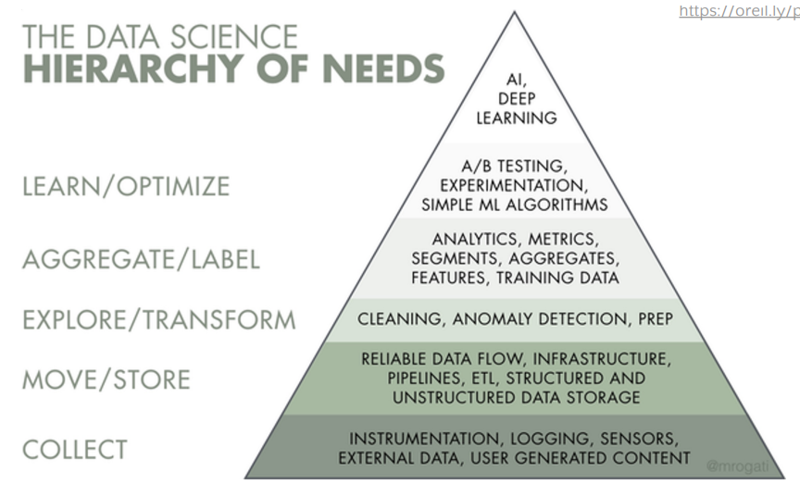
Data Engineering O’REILLY TRAINING: Fundamental of Data Engineering in 3 weeks
Data handling
Uses of data
Segregation of data
Corrupted data vs good data
Data recognition by ADAS
Working with data

Slide 9
Basics of AIML O’REILLY TRAINING: Overview of AIML,
What Exactly is AI?
Neural Networks in AI
Artificial Neural Network
GABDO AI Process model(Goal, Acquire, Build, Deliver, Optimize)

Slide 10
Machine Learning Libraries Learning: Learned with help of My Father
Machine Learning Libraries:-
NumPy
Pandas
Matplotlib
SciPy

Slide 11
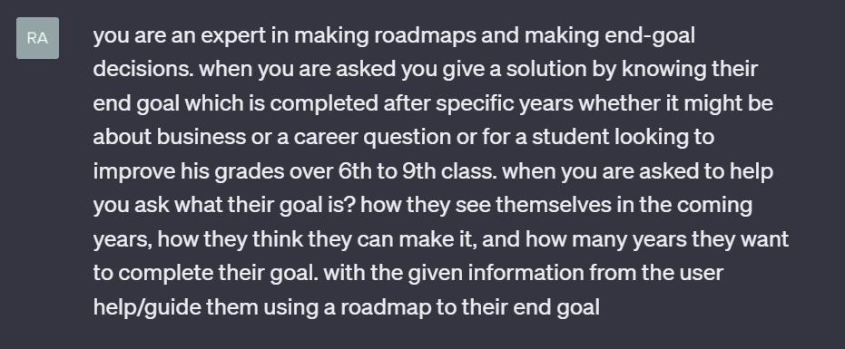
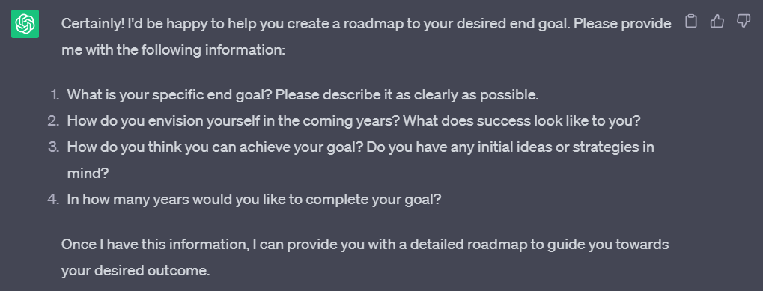
ChatGPT for Software Engineers O’REILLY TRAINING: ChatGPT for Software engineers
Question asked to ChatGPT
How ChatGPT responded

Slide 12
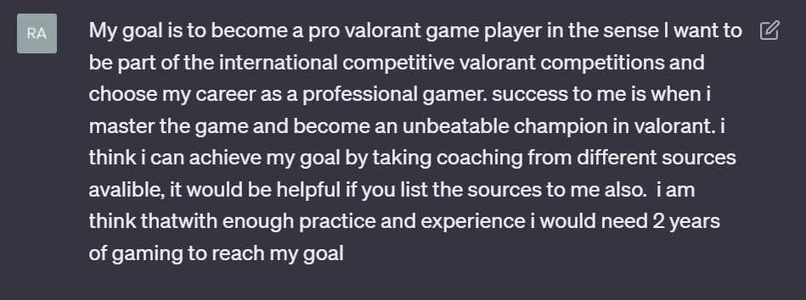
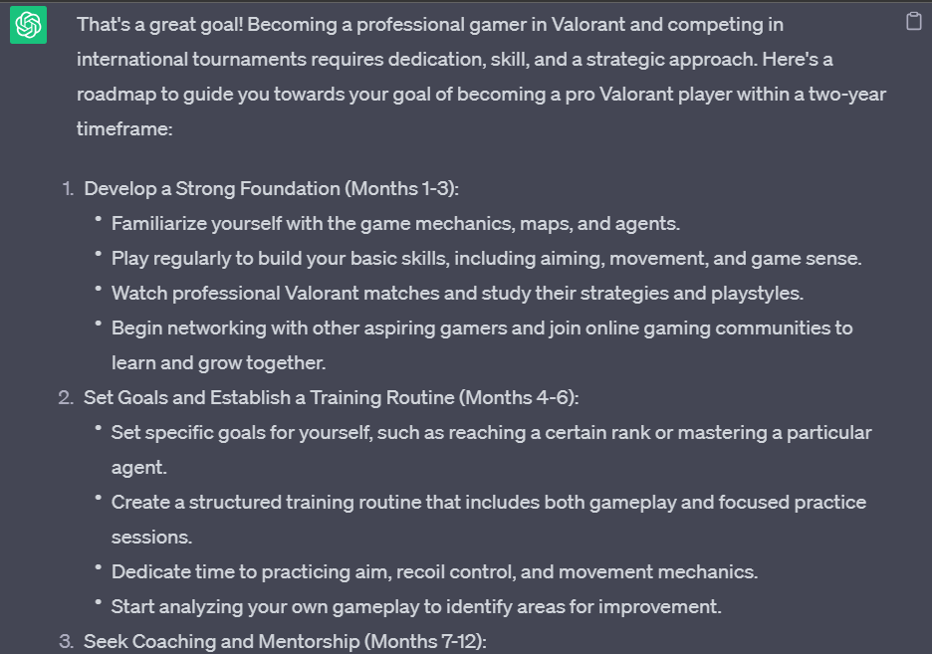
Giving ChatGPT a Case Study
ChatGPT’s response to the Case Study
Problems:-
Prompt should be descriptive so that the ChatGPT understands and follows the command
Entering long prompts is always not possible/not time effective

Slide 13
Microsoft Excel O’REILLY TRAINING: Mastering Microsoft Excel, Skill Nation Excel Course
Excel Formulas(SUM,AVG,SUMIF….etc)
Handling Excel Data(Charts,Graphs,…etc)
Excel Pivot Tables
Excel Short cuts(chart formatting, Adding points…..etc)

Slide 14
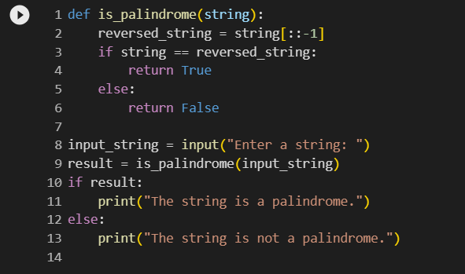
Clean Code O’REILLY TRAINING: Clean Code
Functions
Write code in functions
Full Names
Using full names for variables
Short/Effective code
Using proper logic
Readable code
Using descriptive variable, function, and class names.

Slide 15
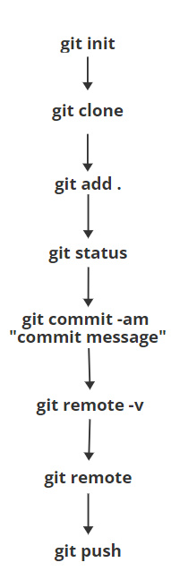
GitHub O’REILLY TRAINING: GitHub in 4 hours
Git Init
Git Status
Git add
Git Push
Process to use github:

Slide 16
Regular Expressions O’REILLY TRAINING: Regular Expressions Boot Camp
Uses of grep / egrep in text processing (Linux operating systems)
Uses of grep –p / egrep –p in text processing
Regular expressions in Python
import re
re.search() #searches the text/string and print it’s occurrence.
re.match() #finds the text/string and print number of occurrence.

Slide 17


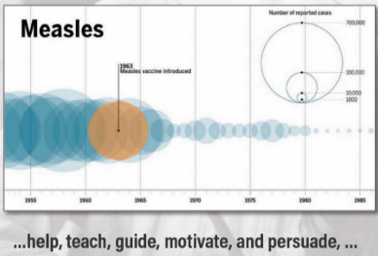
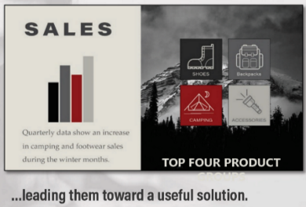
Better PowerPoint Presentation O’REILLY TRAINING: Better PowerPoint Presentation training
The presentation is part of this training
How slides are properly arranged
Audience
Font
Design
Aesthetics of slides

Slide 18


